Slide 1

HAF AOR GRANT OUTREACH COMMITTEE
HAF Local Association Grant
Advancing Housing Affordability
Across California Communities
The California Association of REALTORS® Housing Affordability Fund partners with local Associations to directly address housing affordability and supply — leveraging contributions to maximize impact statewide.
A Guide to
Application &
Implementation
CALIFORNIA ASSOCIATION OF REALTORS® HOUSING AFFORDABILITY FUND

Slide 2
SECTION 01 — OVERVIEW
Application Guidelines
$50,000
01
Contributing Funds Requirement – Min. (1/3)
02
Two-Year Aggregate Grant Cap
Maximum aggregate grant per Association
03
Flexibility to Partner with Other Organizations
Guiding principles that balance flexibility for program growth with equitable, statewide distribution of HAF resources.
04
Area Median Income (AMI) 150% Requirement (Max)
05
Buyer Represented by a California REALTOR®
06
REALTOR® Participation in Presentations
07
Application Forms Made Easy
HAF Local Association Grant • AOR Grant Outreach Committee
2 / 8

Slide 3


SECTION 02 — FUNDING STRUCTURE
Contributing Funds & Two-Year Cap
CONTRIBUTING FUNDS
TWO-YEAR AGGREGATE
One-Third Matching Requirement
Grow Grants Over Time
⅓
Associations applying for HAF grant funding must provide documented contributing funds equal to at least one-third of the grant amount requested — up to a total HAF contribution of $50,000.
Year 1
Amend
Year 2 Cap
Associations may reapply, amend, or extend
for incremental amounts across a two-year term — provided the total awarded does not exceed the $50,000 cap.
After the term, a three-year gap is required before submitting a new application.
MINIMUM ASSOCIATION MATCH
HAF Local Association Grant • AOR Grant Outreach Committee
3 / 8

Slide 4


SECTION 03 — LEVERAGE & ELIGIBILITY
Partnerships & Income Requirements
PARTNERSHIP FLEXIBILITY
INCOME ELIGIBILITY
Leverage Additional Resources
150% AMI Requirement
A local Association may supplement HAF funds with contributions from outside partners to maximize housing impact.
150%
Lenders
Government
Agencies
Nonprofits
Housing
Advocates
OF COUNTY AREA MEDIAN INCOME
Associations submitting grant requests must utilize a Qualifying Mortgage when applying income limits. Grants are awarded only to participants whose income does not exceed 150% of the county's AMI and who meet all other program requirements.
LETTER OF INTENT If partner funds are not yet received, provide a Letter of Intent documenting each contributor's commitment.
HAF Local Association Grant • AOR Grant Outreach Committee
4 / 8

Slide 5



SECTION 04 — PROGRAM REQUIREMENTS
REALTOR® Representation & Fund Integrity
BUYER REPRESENTATION
COMMITTEE PRESENTATIONS
FUND RECOVERABILITY
Must Be Represented by a California REALTOR®
REALTOR® Participation Required
Unused Funds Return to HAF
The grant is available to a Buyer only when they are represented by a California REALTOR® — ensuring professional guidance through the transaction.
A REALTOR® must participate in the local Association's application presentation to the HAF Committee, reinforcing professional accountability.
Where possible, any HAF funds not used within the one- or two-year term are returned to HAF — preserving resources for statewide impact.
HAF Local Association Grant • AOR Grant Outreach Committee
5 / 8

Slide 6

SECTION 05 — BEST PRACTICES
Suggestions to Associations
PRACTICE 01
PRACTICE 02
Fair Opportunity for Every Agent
Impartial Program Structure
3
Where possible, programs should limit HAF funds to three home-purchase transactions per individual REALTOR® agent.
Applications should be reviewed by a task force or committee of individuals without bias or conflicts of interest.
No personal benefit from funding decisions
Preference should go to REALTOR® agents who haven't yet closed any home-purchase transactions using HAF funds — giving every agent a fair opportunity to serve their clients.
TRANSACTIONS
PER AGENT, MAX
No family or close relationships with applicants
No business interests tied to outcomes
Demonstrated objectivity in prior roles
HAF Local Association Grant • AOR Grant Outreach Committee
6 / 8

Slide 7
















SECTION 06 — PROGRAM EXAMPLES
Examples of Grant Programs
TYPES OF PROGRAMS
WHO THE PROGRAMS SERVE
Downpayment Assistance
Insurance Premiums
First-Time Home Buyers
First Responders
Fire Insurance for First-Time Buyers
Closing Cost Assistance
Military & Veterans
Police
Rate Buy-Downs
Necessary Repairs to Close Escrow
Firefighters
Doctors & Nurses / EMT-EMS
Educators
Public Servants
Inspection Reimbursements
No-Interest Loans
Low-Income Individuals
HAF Local Association Grant • AOR Grant Outreach Committee
7 / 8

Slide 8

HAF AOR GRANT OUTREACH COMMITTEE
Thank You.
The C.A.R. Housing Affordability Fund Committee welcomes your grant application — we are here to serve the members of the California Association of REALTORS® and to facilitate homeownership opportunities.
FOR MORE INFORMATION
haf.car.org
We look forward
to partnering
with you.
SCHEDULE A PRESENTATION FOR YOUR LOCAL BOARD
haf@car.org
CALIFORNIA ASSOCIATION OF REALTORS® HOUSING AFFORDABILITY FUND

Slide 9
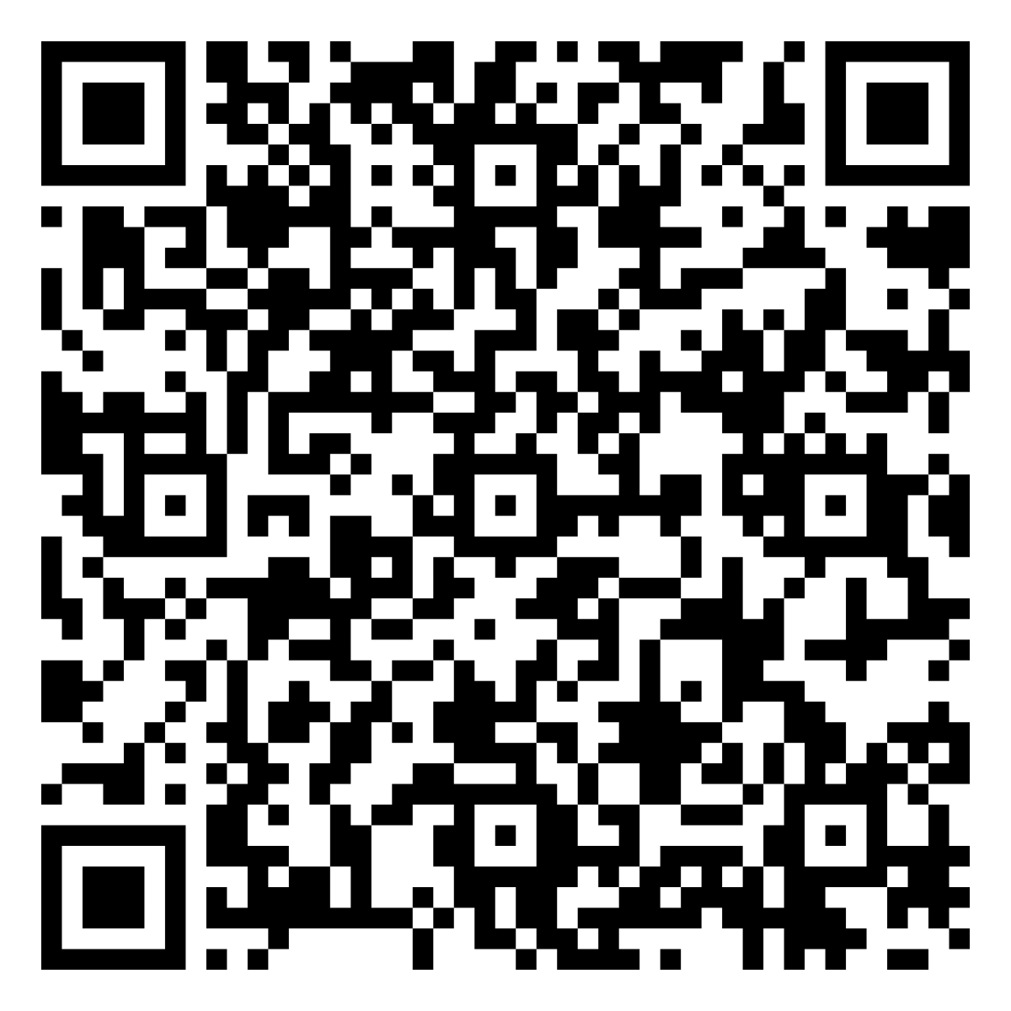
QR to Application
Please fill out BOTH the
HAF Funding Request Form_Fillable PDF and the
HAF Request Grant Workbook.
Email both files to haf@car.org
HAF Local Association Grant • AOR Grant Outreach Committee

Slide 10
SECTION 07 — APPLICATION
Application Process
01
Clear Instructions
6 Easy Parts
02
Word Narrative
03
Excel Numbers
Guiding principles that balance flexibility for program growth with equitable, statewide distribution of HAF resources.
04
Presentation to The Committee
05
REALTOR® Participation in Presentations
06
Application Forms Made Easy
07
HAF Local Association Grant • AOR Grant Outreach Committee
2 / 8

Slide 11
QR to Application
Please fill out BOTH the
HAF Funding Request Form_Fillable PDF and the
HAF Request Grant Workbook.
Email both files to haf@car.org
HAF Local Association Grant • AOR Grant Outreach Committee

Slide 12
SECTION 05 — BEST PRACTICES
Suggestions to Associations
PRACTICE 01
PRACTICE 02
Fair Opportunity for Every Agent
Impartial Program Structure
3
Where possible, programs should limit HAF funds to three home-purchase transactions per individual REALTOR® agent.
Applications should be reviewed by a task force or committee of individuals without bias or conflicts of interest.
No personal benefit from funding decisions
Preference should go to REALTOR® agents who haven't yet closed any home-purchase transactions using HAF funds — giving every agent a fair opportunity to serve their clients.
TRANSACTIONS
PER AGENT, MAX
No family or close relationships with applicants
No business interests tied to outcomes
Demonstrated objectivity in prior roles
HAF Local Association Grant • AOR Grant Outreach Committee
6 / 8

Slide 13
SECTION 01 — OVERVIEW
Application Guidelines
$50,000
01
Contributing Funds Requirement – Min. (1/3)
02
Two-Year Aggregate Grant Cap
Maximum aggregate grant per Association
03
Flexibility to Partner with Other Organizations
Guiding principles that balance flexibility for program growth with equitable, statewide distribution of HAF resources.
04
Area Median Income (AMI) 150% Requirement (Max)
05
Buyer Represented by a California REALTOR®
06
REALTOR® Participation in Presentations
07
Application Forms Made Easy
HAF Local Association Grant • AOR Grant Outreach Committee
2 / 8

